Slide 1
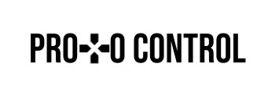
ProtoControl
A User Interface Development Cheat Code
Kelly Mae Allen
Notes:
Intro
Example user and how competitors don’t meet their needs
Functional Block Diagrams
System
User Flow
Subsystems
Designing a User Interface
Website
Peripherals
Implementation with User Interface
Integration (command library)
Communication
Microcontroller change
Functionality while systems running
Embedded
PCB
Power
Enclosure
Conclusion
“That’s why Shannon chooses protocontrol”
Demo Day Plans
Demo
Questions

Slide 2
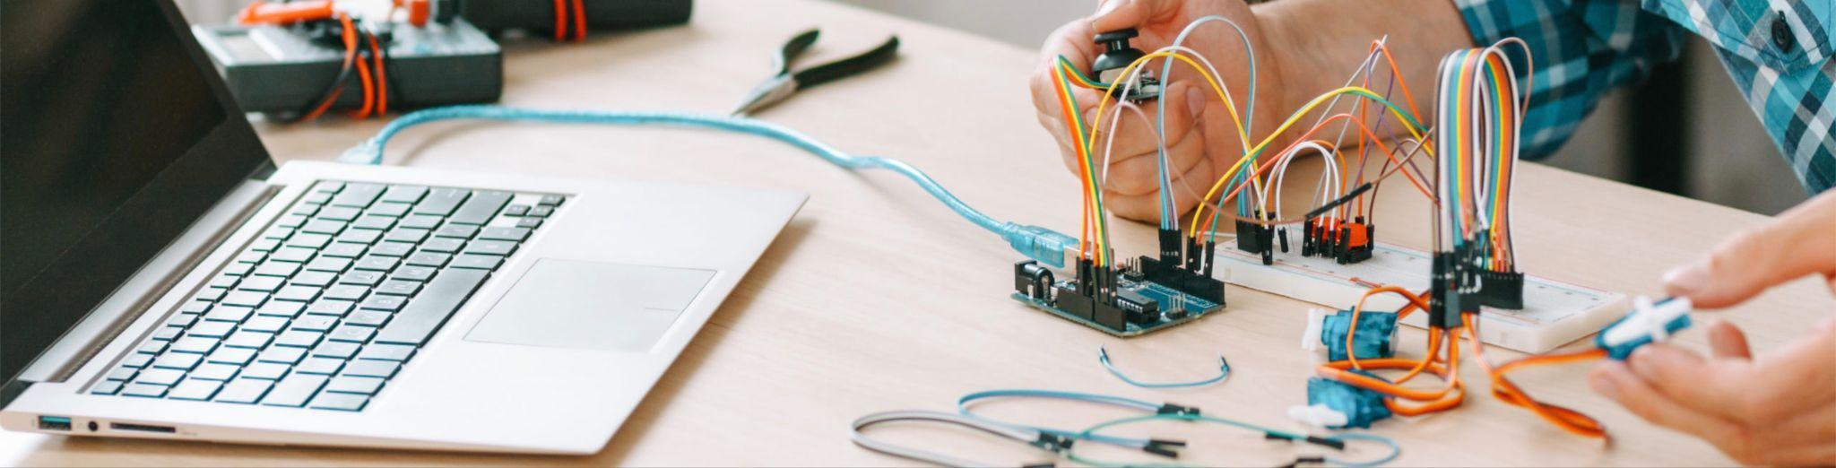
Notes:
When you’re designing a product, building a UI is often one of the most stressful parts.

Slide 3
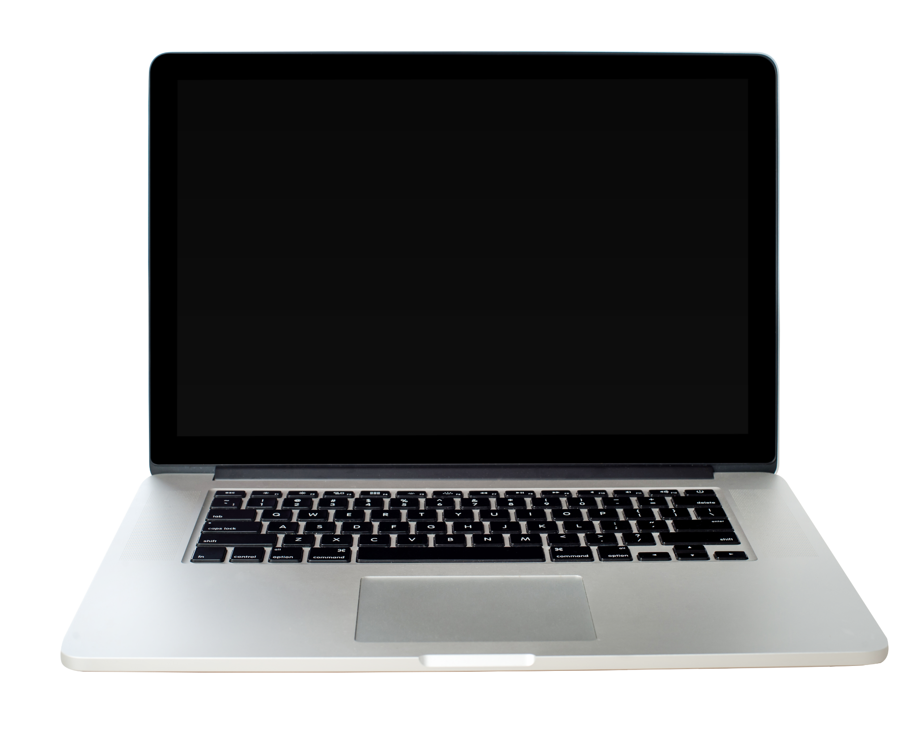
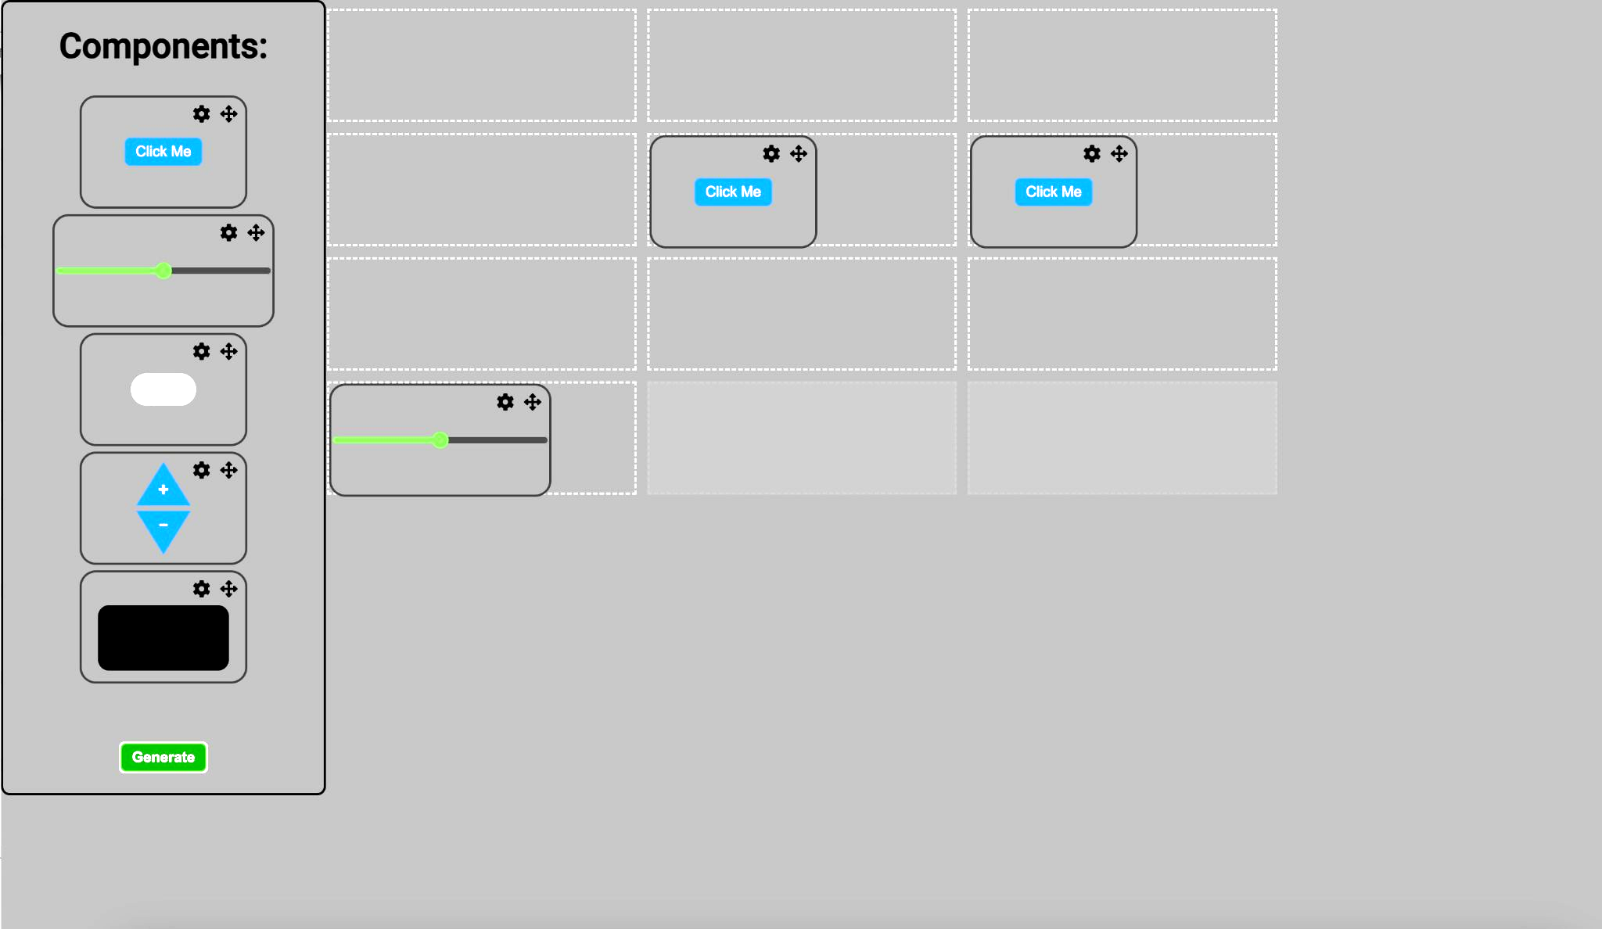
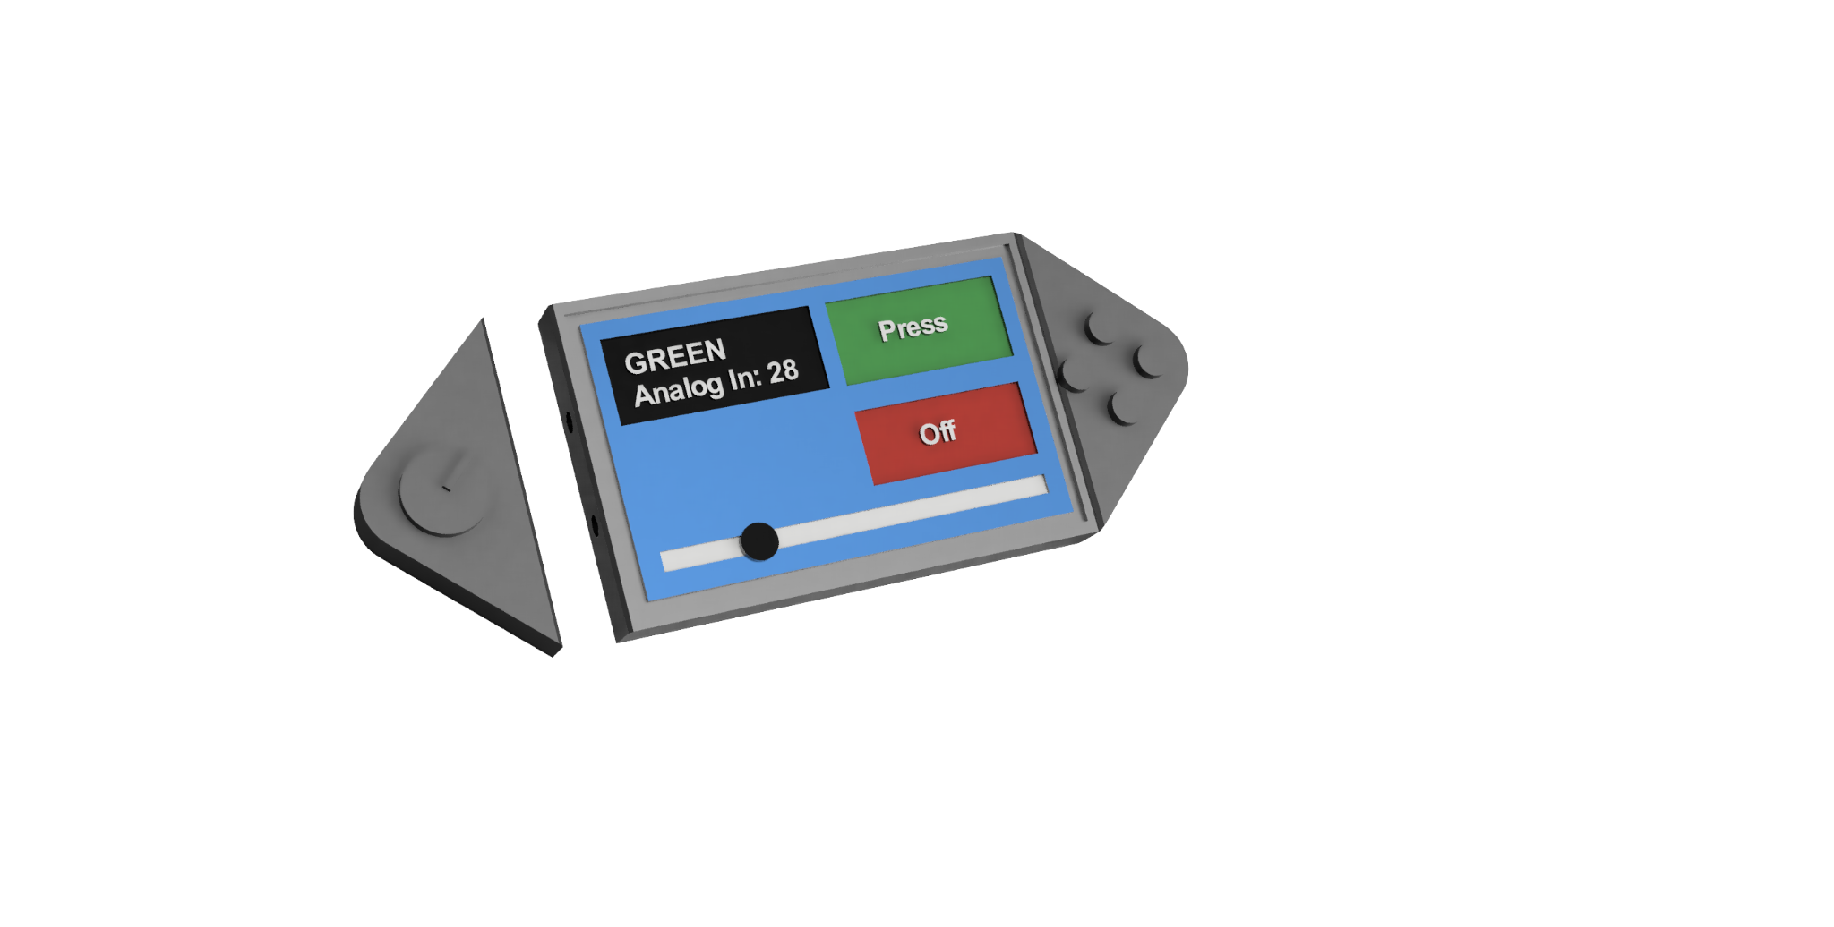
ProtoControl
A plug and play panel with a start-to-finish user interface development experience.
Proprietary Software Platform
Compatible with industry standard technology
Hot Swappable Custom Hardware
Configurable Touch Screen Display
Notes:
Protocontrol allows engineers and hobbyists to execute their vision for a user interface panel with a start-to-finish user interface development experience
Bring the audience to the same place as us before diving into details, set the tone, differentiate ourselves from other projects
Software platform to design user interface layout
Touch-screen display
Hot swappable hardware
Compatible with industry standard technology

Slide 4
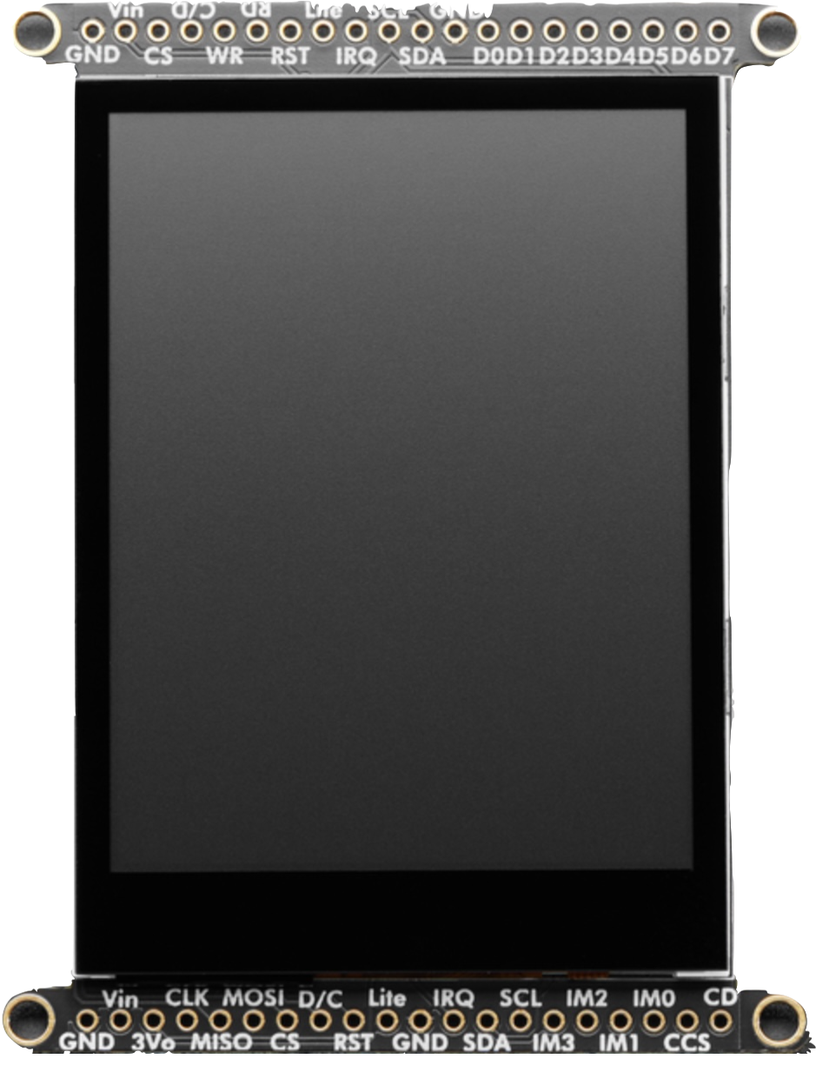
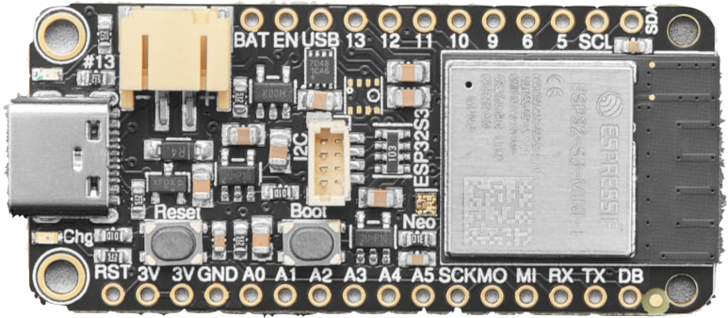
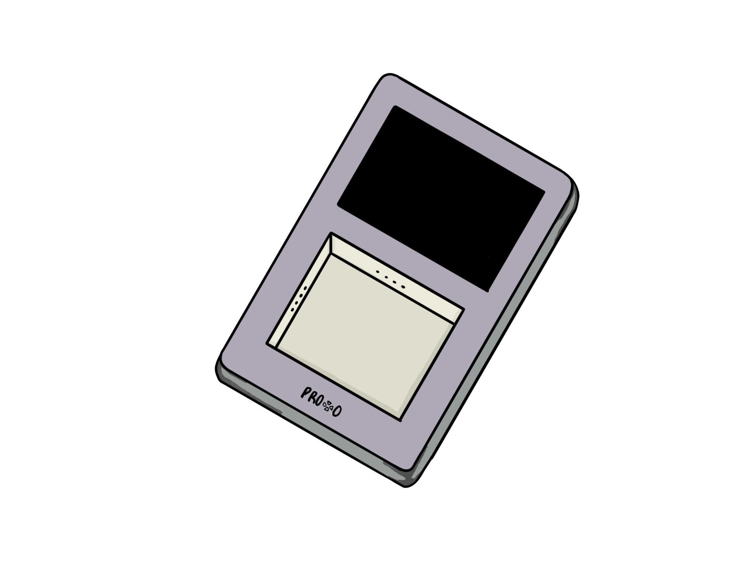
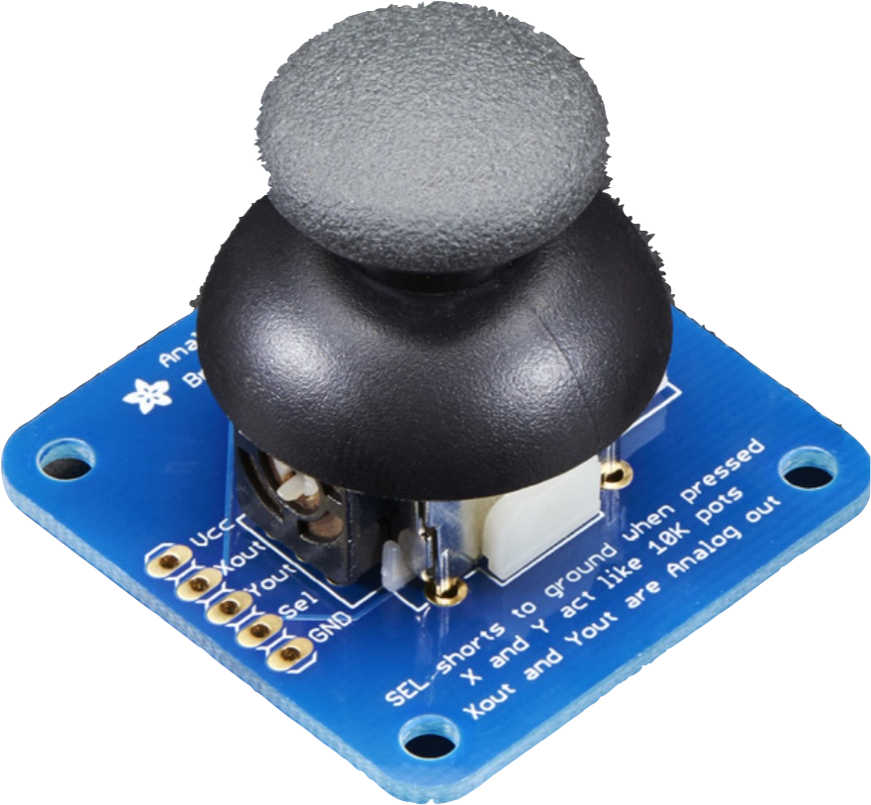
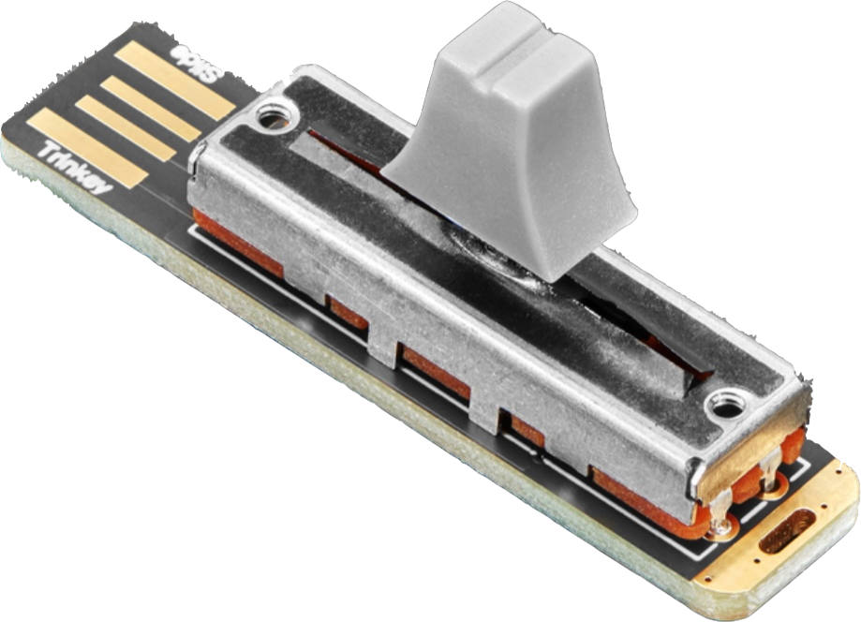
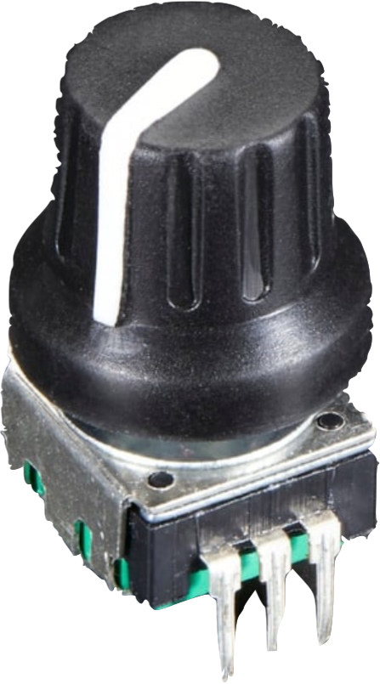
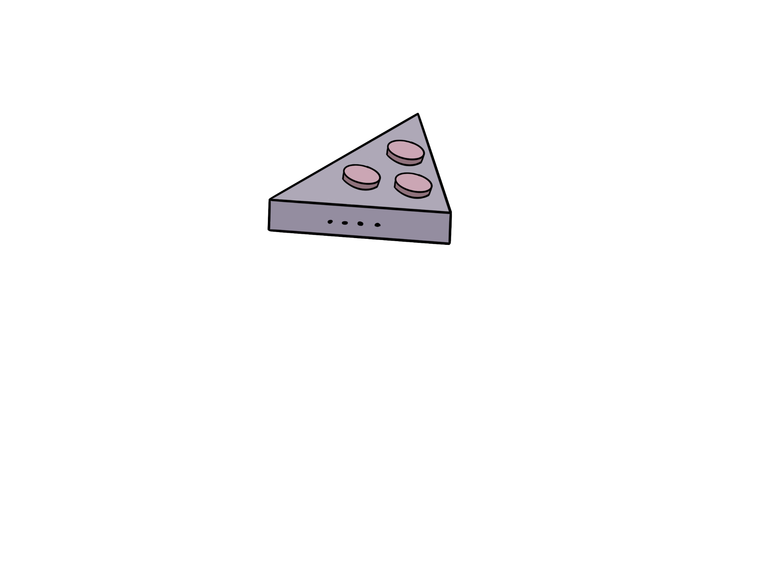
Features
2.8” TFT
Embedded System
- Capacitive Touchscreen
- Peripheral UI Modules
- I2C, SPI, Seral, and Wifi
Custom Enclosure
- Magnetic Connectors
- Accessible Ports
- Mounting Options
Proprietary Software
- Custom Placement
- Custom Component
Parameters
- Accessible to users of all
skill levels
ESP32 Feather
I2C Hardware

Slide 5
Requirements
The User can easily:
Design a User Interface
Receive inputs
Send and display outputs
Change their design

Slide 6


Example Users
Shannon
Senior Embedded Engineer
Tasked with designing a test bench for a production line
Needs to have prototype ready ASAP
Julia
10th Grade
Familiar with simple block coding
Wants to make cool projects
Needs to easily display values
Notes:
Meet Julia. Julia represents our hobbyist market. Julia is in 10th grade. She has some experience with simple block coding but wants to branch out with some personal projects. Unlike Shannon, her critical constraint isn’t time. She needs something that can manage complexity without having a high barrier to entry.

Slide 7
Integration between Protocontrol and User System
Shannon - Industry Professional
Julia - Hobbyist
Goal: Design a test bench ASAP that can be easily updated
MCU: TI MSP 430
UI Req:
- Display temperature and voltage
- Start test cycle
- Show pass/fail
Protocontrol Implementation:
Design a User Interface
Receive Inputs
Display Outputs
Goal: Design a room security system with limited complexity
MCU: Arduino Uno
UI Req:
- Activate/deactivate system
- Control speaker volume and lights
- View system state
Protocontrol Implementation:
Design a User Interface
Receive Inputs
Display Outputs

Slide 8
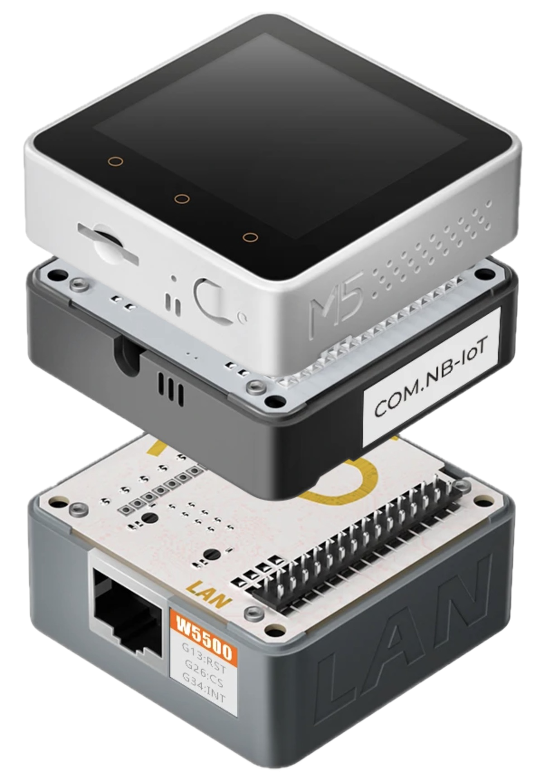
Why ProtoControl?
Goal: build a custom user interface | Touch Display | M5Stack | Protocontrol
Interfaces with user microcontroller | Common Protocol | Need Additional Modules | Any MCU with UART
Easy to set up | Strong learning curve | “Stack and Play” system | Design on the Web and Upload
Required Programming Experience | Extensive experience needed | Block Coding or Library Design | Little Experience Needed
Can change without uploading code | Must Compile and Upload | Must Compile and Upload | Design on the Web and Upload
Hardware and Software interface | Software Only | Need Additional Modules | Hardware and Software
Notes:
Competitors -
The perfect middle ground between add on screen and all in one
Included microcontroller
We are a service not just a product

Slide 9
How Does
Protocontrol Work?

Slide 10
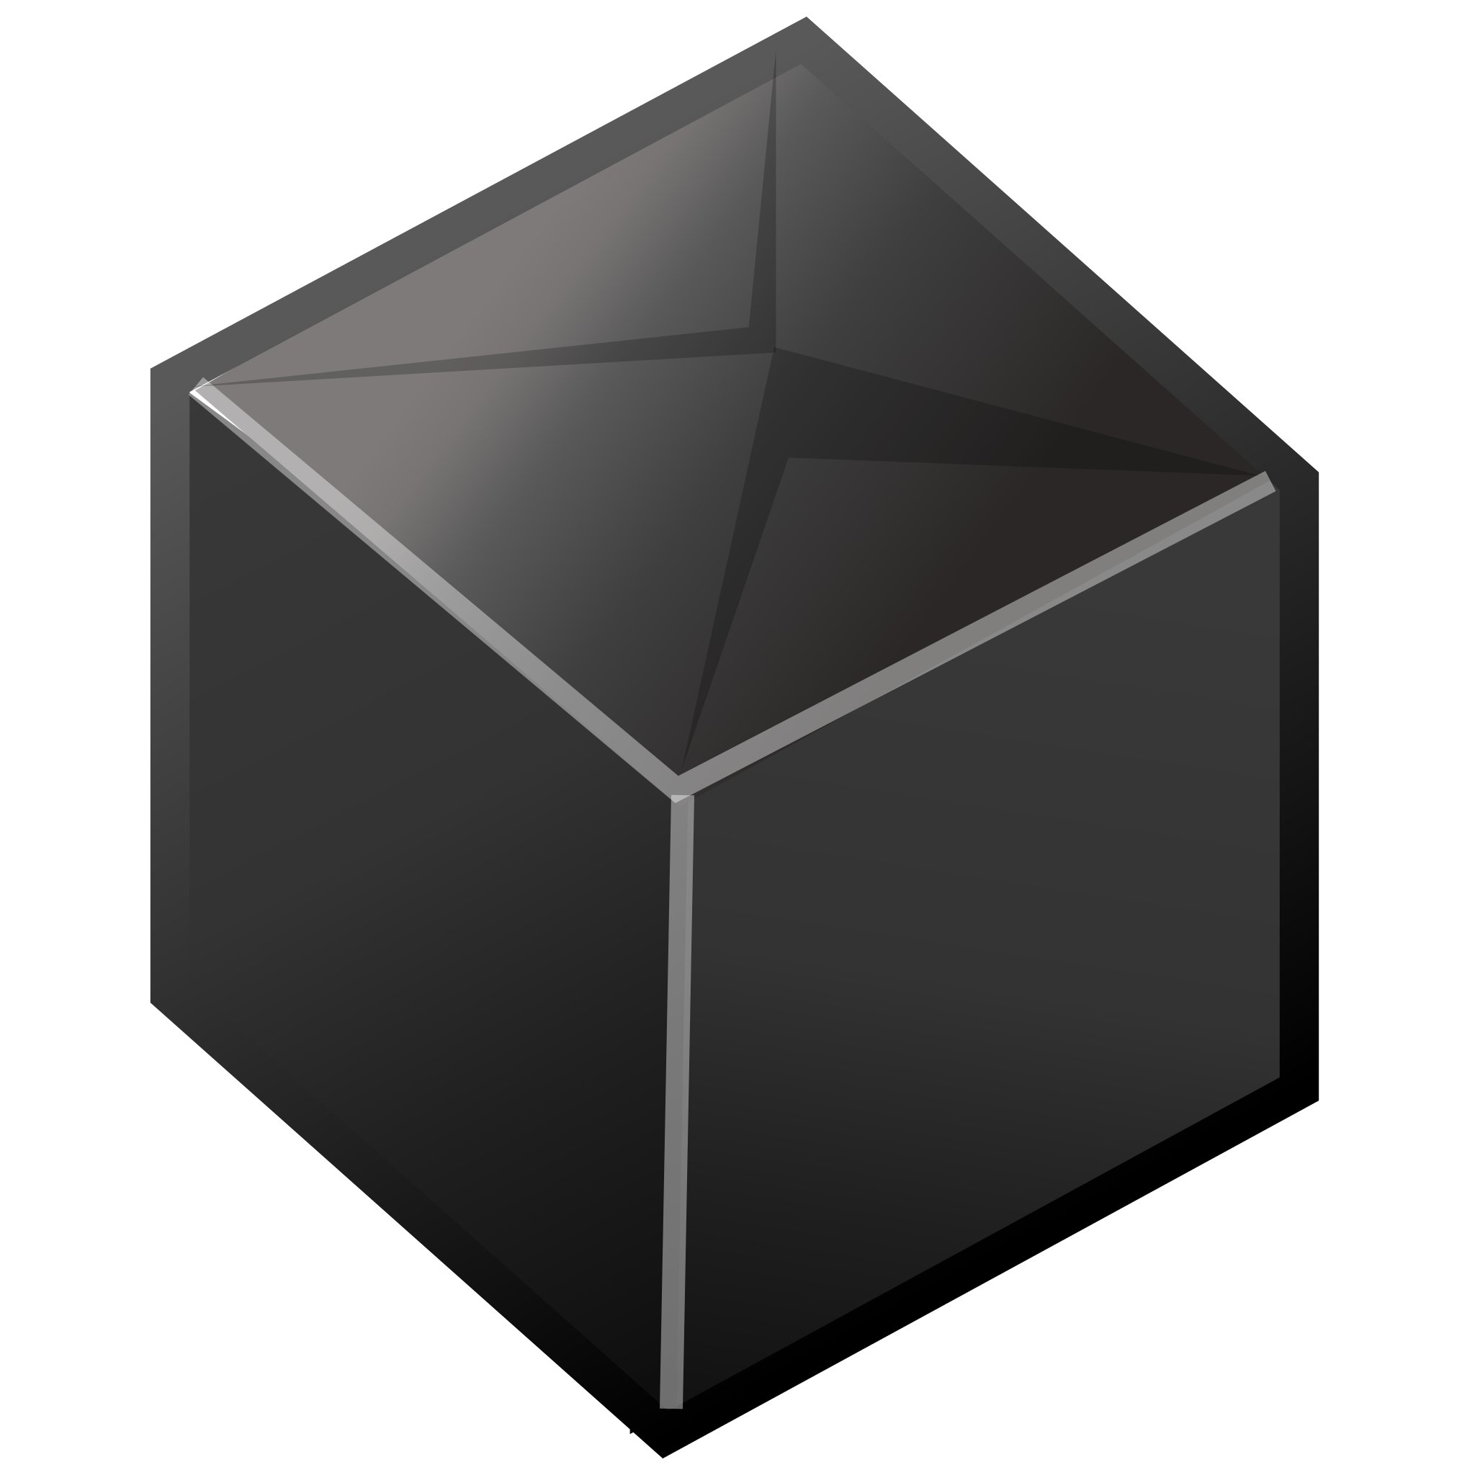
System Flow
Design
Send
Connect
Website
Protocontrol
User System

Slide 11
System Flow Diagram
Designing of User Interface
Uploading Design & Connect to User
Functionality While User System is Running
1)
2)
3)
User Chooses Layout of Components
Protocontrol Creates Components
Protocontrol Monitors UART Channel to Send & Receive Updates
User
User Configures Component Properties
Protocontrol Saves the Profile
Protocontrol Monitors Component State
Website Processes Placement and Configuration
User Implements Read and Write Commands
Protocontrol Sends Component State Updates
Protocontrol
Website Produces Configuration Commands
User Connects System UART Channels
User Monitors UART Channel to Send & Receive Updates
Notes:
Add legend and clip art
Speaker Note:

Slide 12
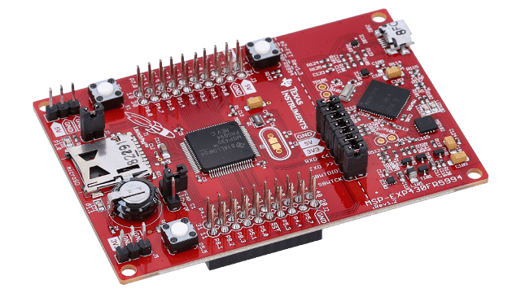
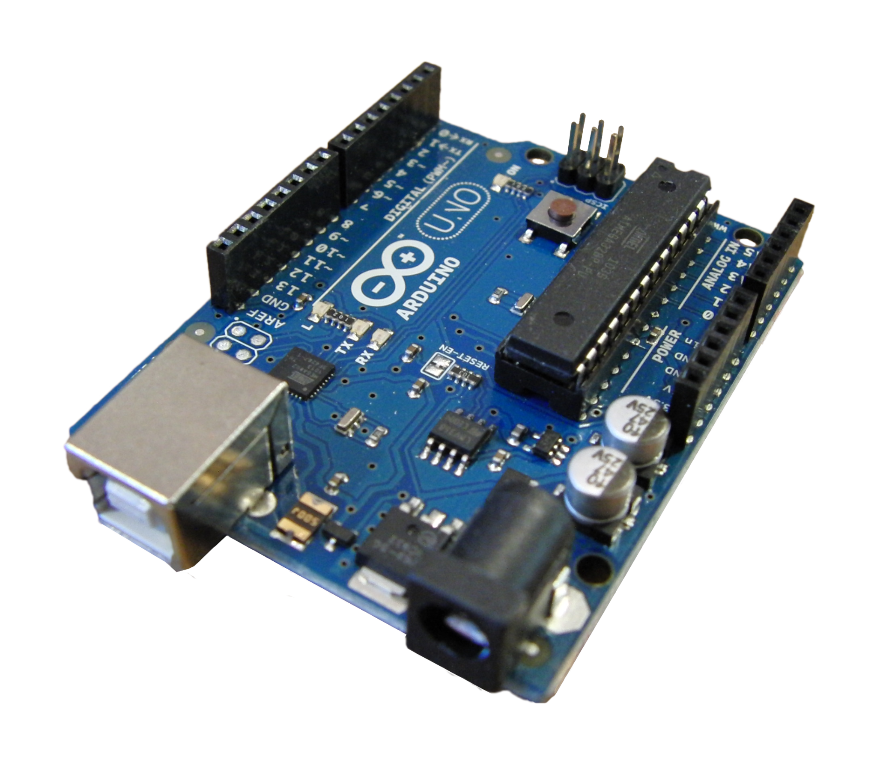
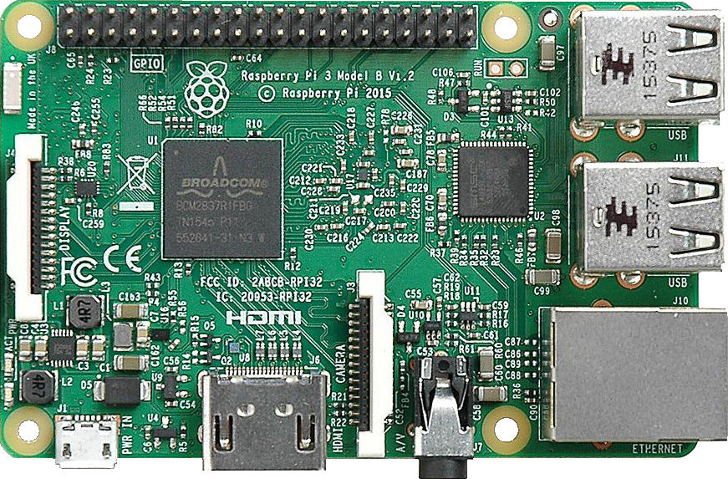
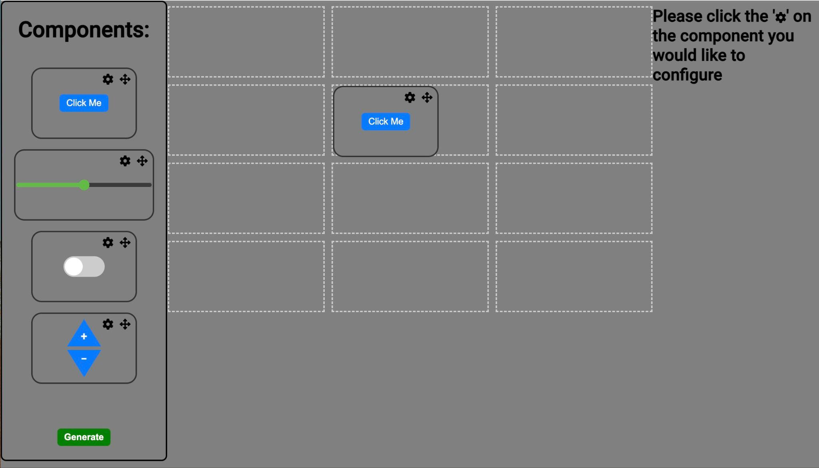
Functional Block Diagram
Can interface with any MCU that has a UART channel
Capacitive
Touchscreen
Display
I2C
I2C Peripherals
SPI
UART
WIFI
Microcontroller
User System
ESP32 Feather
Website

Slide 13
Communication
& Integration

Slide 14
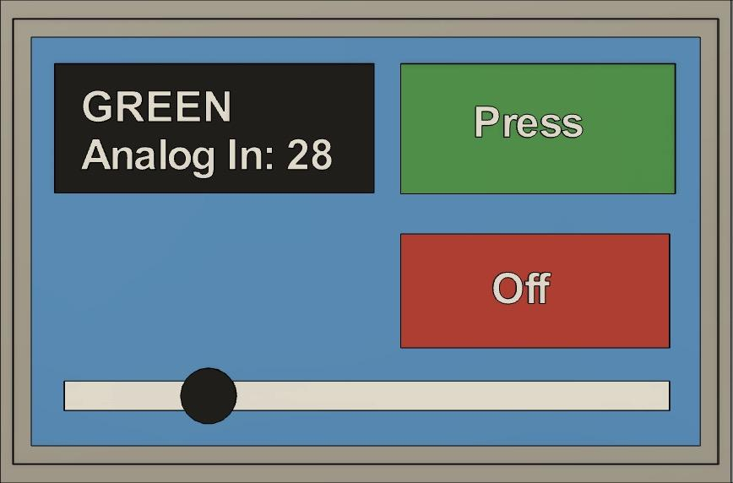
Communication & Integration
Website Profile
- User builds desired profile on website & saves to database
- Protocontrol gets the profile via an HTTP request to our listed endpoint
-The endpoint returns the most recent profile created on the site
Control Profile
- Protocontrol firmware takes string generated by website - Dynamically casts the user’s profile from given parameters using screen location and initial values.
Send and Receive Updates
- During operation, Protocontrol looks for inputs to the local components and updates from the user device
- By monitoring the UART channel, Protocontrol updates values on screen and sends input updates
UART
WiFi

Slide 15
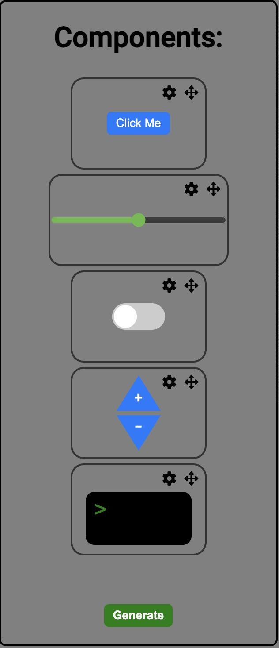
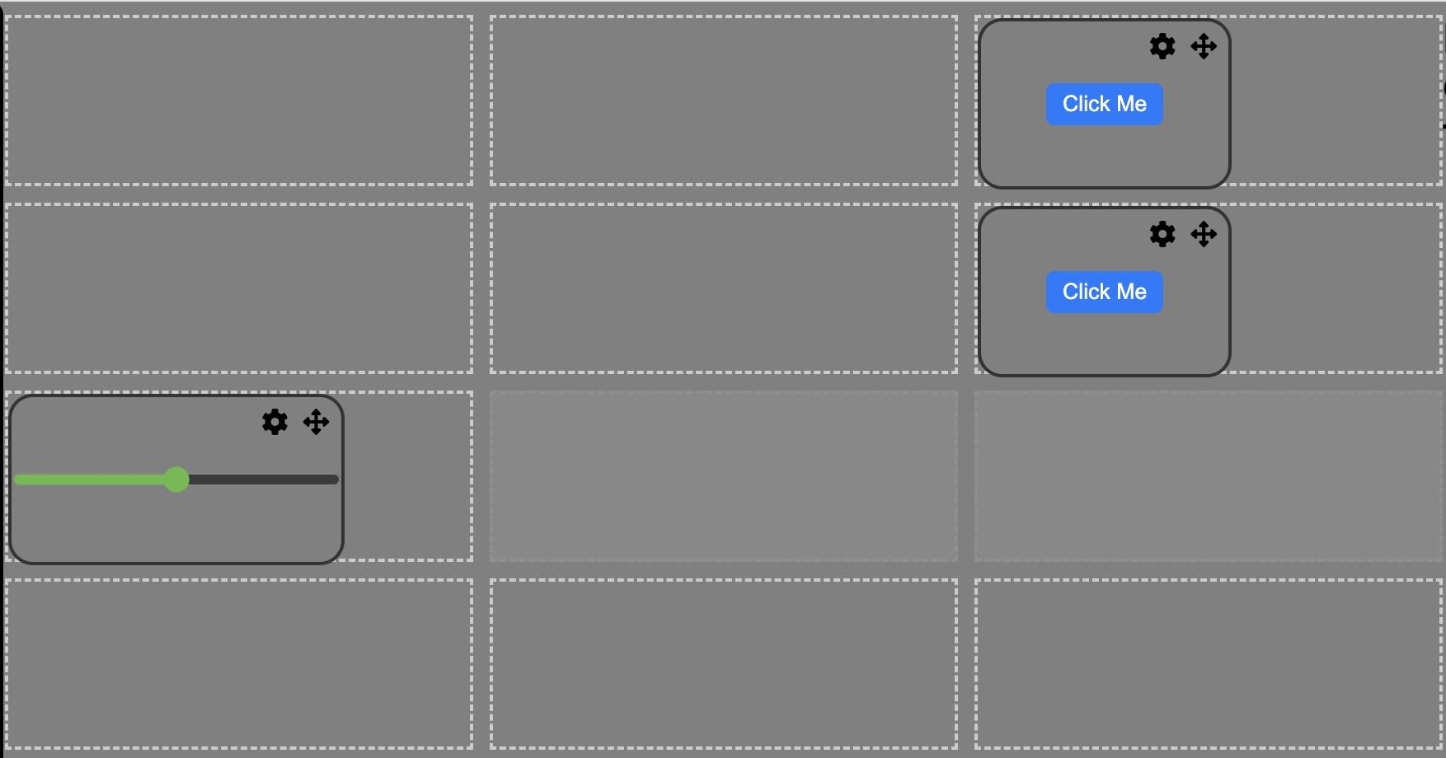
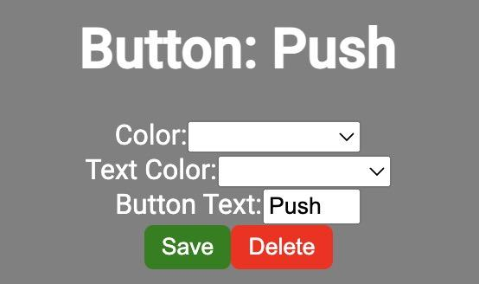
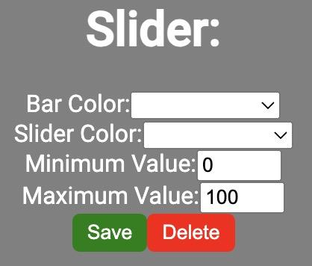
Website & Software
Component Selector provides elements for the user to create the profile they want
Component grid allows simpler communication protocol and dynamic component creation
Parameter Selection allows for custom components for a unique user interface
Notes:
Framework/Library used to build website: Angular - Industry standard frontend framework, component based design
Backend (Database HTTP endpoints): Flask - web microframework, hosts our HTTP endpoints and interacts with database
Database:SQLite very lightweight version of sql, not officially ‘hosted’ its all stored in a file that the Flask server has access to

Slide 16
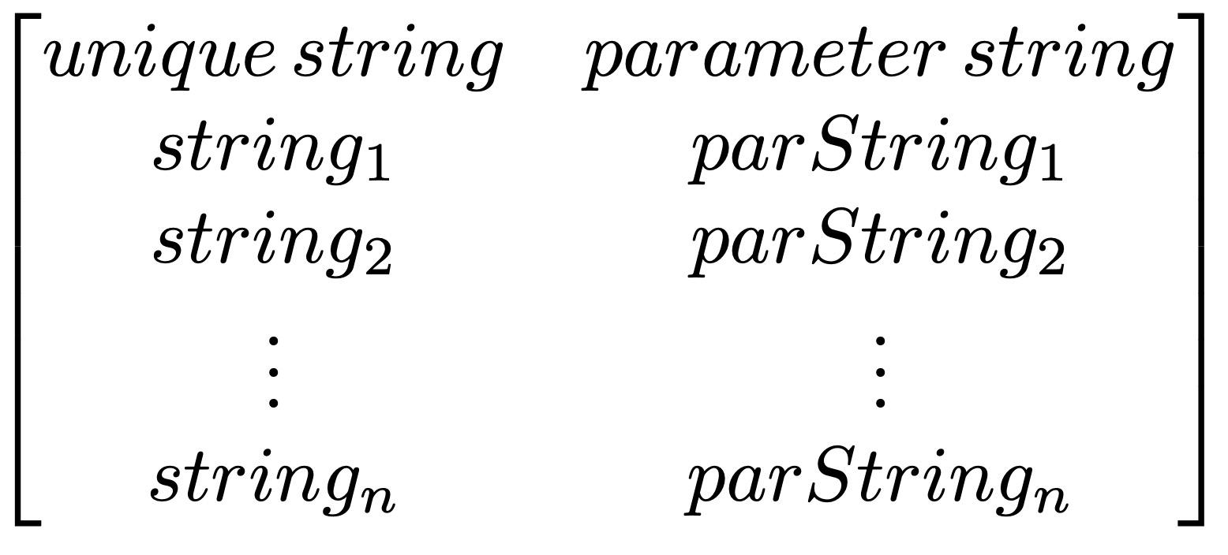
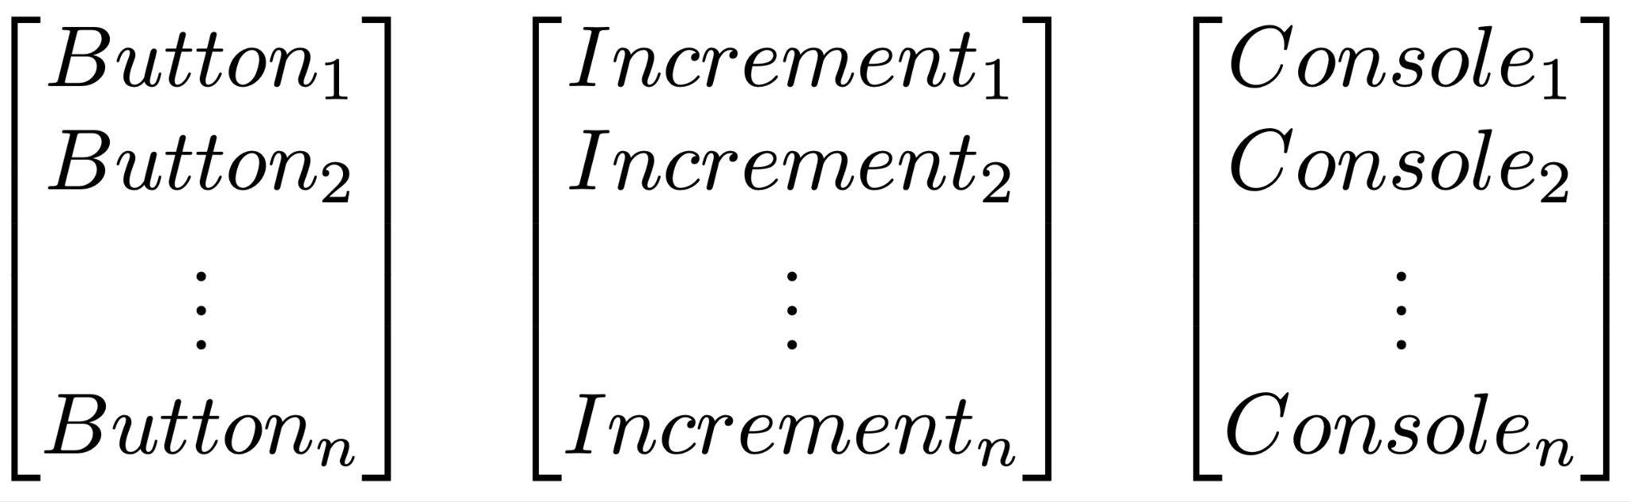
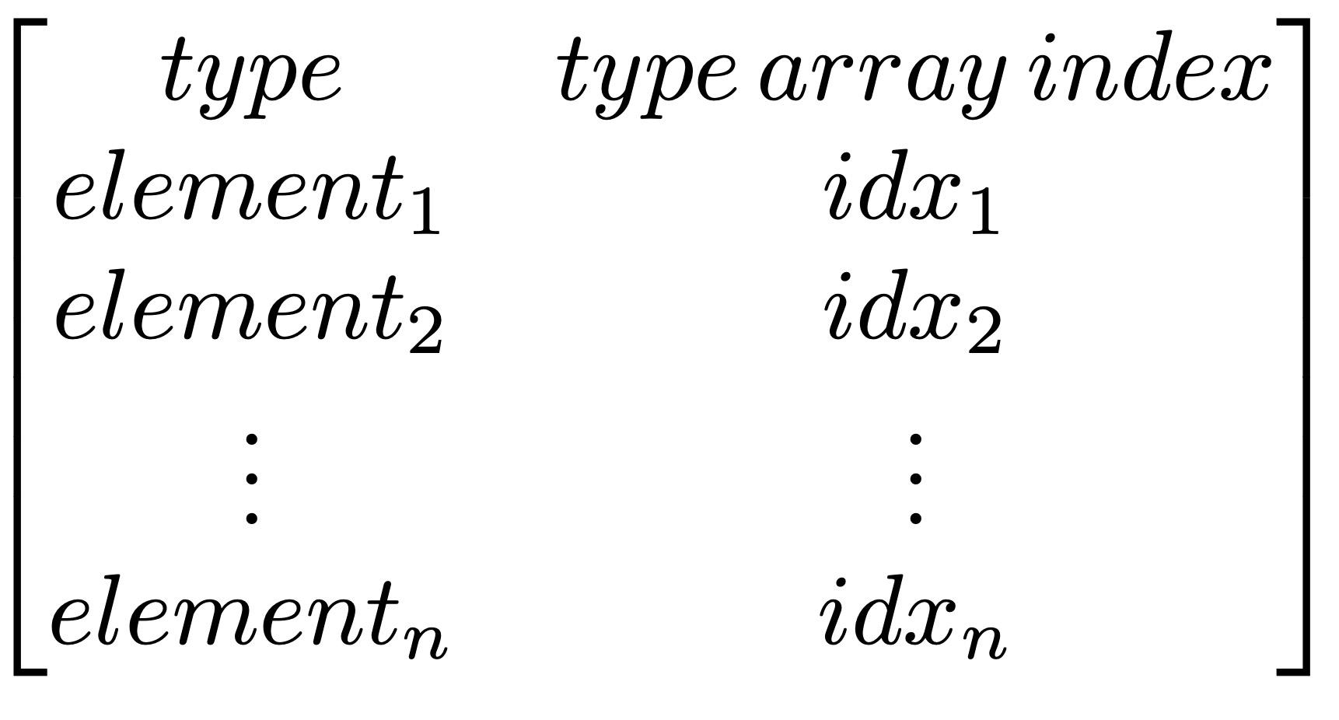
Communication Between Website and Protocontrol
Example Message
PushButton,
20,20,
0x780F,0xC618,
0x780F,0xC618,
PRESS,
,|,
Toggle,
200,120,
0xF800
index
Type
Location
Parameters
Delimiter
Online Database
System Flow
Type Arrays
Get string from web
Construct an instance of the type class
Place instance in type array
Place type and location in the profile array
Retrieve from database
Constructor Draws Components
Save for future uses (menu, reset, ect.)
Index components of profile for future use
Profile Array

Slide 17
Integration between Protocontrol and User System
Command Protocol
+[component tag]|[value]
x1
x2
x3
Component Tag
- Each component is assigned a unique component identifier assigned by the website that is known to the user
Digital Component
Tag assigned by grid location on website
Hardware Component
Tag assigned by website when chosen
x4
x5
x6
x7
x8
x9
xA
xB
xC
Notes:
Not rlly sure how this slide is relevant, at the very least it should not be the first slide for this subsystem

Slide 18
Embedded Communication Implementation
User MCU
if(Serial1.available()){
msg = Serial1.read();
if(msg == '+out1')
display(out1);
UART
Protocontrol
while (client.available()) {
char c = client.read();
Serial.write(c);
IOT
Website

Slide 19
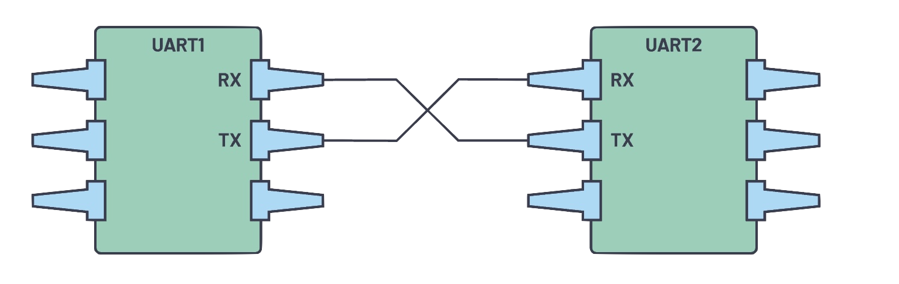

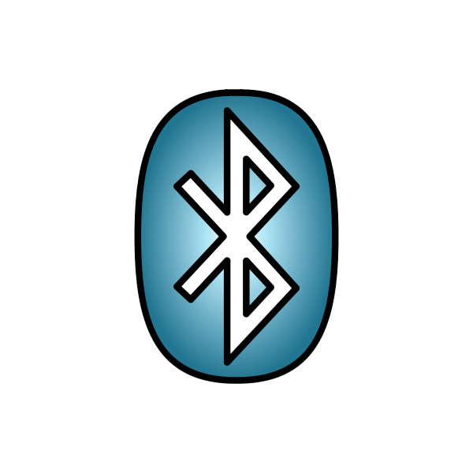
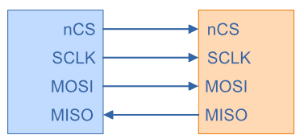
Communication Method Between Protocontrol and User
 | Channel | Link to Protocontrol | Pros | Cons
UART Comm (current configuration) | Hardline Wired Connection |  | - Easy to implement - Freedom of design - Accessible on most Microcontrollers | - Not viable for large messages - Wired connection
TCP via IOT Device | WiFi |  | - Easy and quick to update Protocontrol - Wireless | - Can be unreliable - hard to set up on new network
Bluetooth | Wireless |  | - Easy to use on most computers for user | - Very difficult for user MCU to communicate with Protocontrol
SPI | Hardline Wired Connection |  | - Common protocol - Can easily interface with multiple user MCUs | - Dedicated port with more pins - Learning curve to set up on user MCU
Protocontrol
User MCU
Website
Legend
Notes:
Conclusion: Should have IOT and UART as both allow for simplest interaction with user for protocontrol update and setup and running operation respectively
ADD: Make a note of data handling and

Slide 20
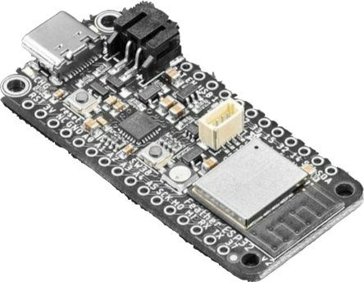
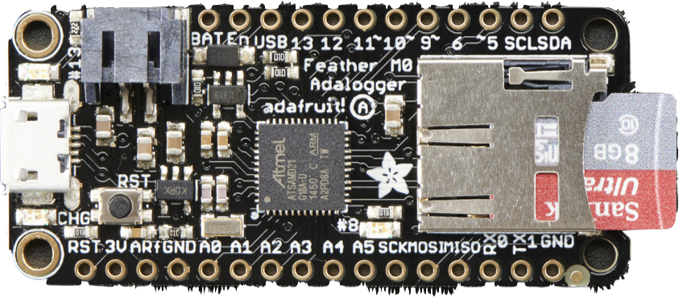
Decision matrix
 | Cortex M0 Adalogger | ESP32 Feather
Chip Type | ATSAMD21G18 @ 48MHz | ESP32 Dual core 240MHz Xtensa® processor
Communication | SD card slot | IOT capabilities
Power Port | Micro USB power | USB - C power
Memory | 256KB of FLASH + 32KB of RAM | 8 MByte of Flash and 2 MByte of PSRAM
Form Factor | Adafruit Feather | Adafruit Feather
ESP 32 Feather
Cortex M0 Adalogger

Slide 21
Embedded System
2.8” TFT
Takes Updates From User
Embedded System
- Capacitive Touchscreen
- Peripheral UI Modules
- I2C, SPI, Seral, and Wifi
Requirements
- Dynamic profile creation
Handles Inputs
Sends Updates to User
ESP32 Feather
I2C Hardware

Slide 22
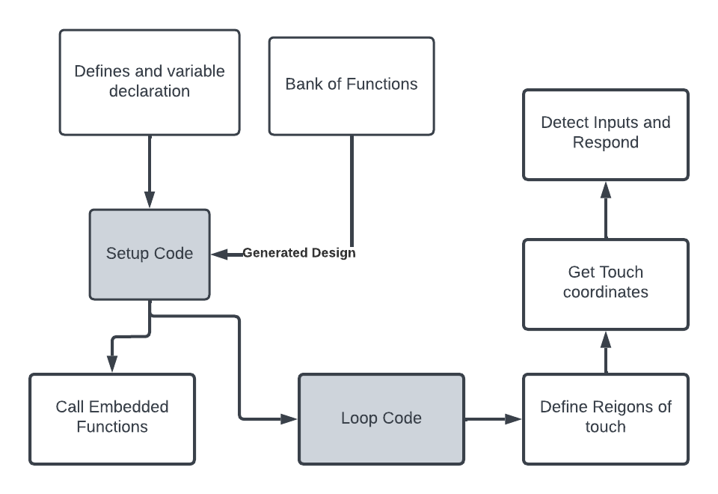
Embedded System Flowchart
Type Arrays
Profile Array

Slide 23
Hardware Peripherals
Why I2C?
Pros | Cons
Can move components between ports | Cannot use two of the same type at once
Lower Power consumption | Slower data rate
Simple and easy to use | Single Ended

Slide 24
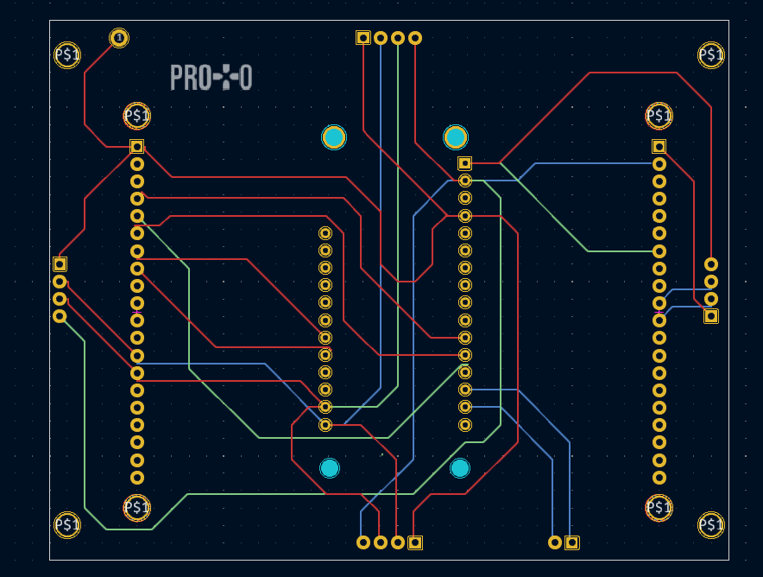
PCB design updates
Progress & Status:
- Main PCB works even when we switch MCUs
- New main board design in progress to accommodate new ideas such as…
Three Layer PCB
SD card
USB port
Power pin
Ergonomic design
Notes:
Split this into a couple slides

Slide 25
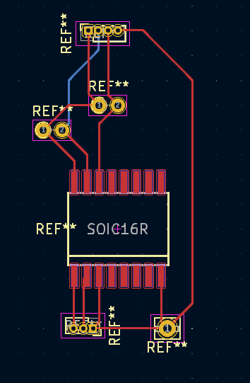
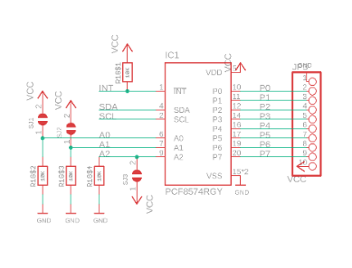
PCB design
Progress & Status: Component PCB designed, enables GPIO Expander (PCF8574) to process I2C input and communicate to the MCU via main PCB.
Notes:
Split this into a couple slides

Slide 26
Issues & Improvements

Slide 27
Website
Challenges | Solution
Integration with Hardware Components | Have the user assign the component tag, but would limit user from hot swapping unless initialized on website
Handling Multiple Profiles | Have user set up profiles within a folder that assigns profile tags to each. Would need to change embedded system to look for profile tag and organize them properly
Choosing between Serial and Wifi Communication | Would need to add additional parameters to the profile (or profile folder) to include the option to use IOT instead of UART

Slide 28
Hardware Components
Challenges | Solution
Integration with Hardware Components | Have the user assign the component tag, but would limit user from hot swapping unless initialized on website.
Handling Multiple Components | Have a set of 4 (number of hardware component connections) for each component. Assign each member of the set a unique address. t

Slide 29
Embedded System
Challenges | Solution
Storage Space | Use an SD card Module to store set-up configurations
Handling Multiple Profiles | Create a new menu class that assigns identifiers to each profile. The user can send an update to change the profile
Setting Up Wifi Connections | Add a hardware button that calls a set up function where the user can choose their network and input their password from the touchscreen
Choosing between Serial and Wifi Communication | Have two operation modes that change if reading from serial channel or IOT. Not sure how to set up IOT
Challenges
Storage Space
Handling Multiple Profiles
Choosing Between Serial and Wifi Communication
Setting Up a Wifi Connection

Slide 30
Communication & Integration
Challenges | Solution
Large Message Size | Utilize encoding techniques to reduce the length of send messages. However, if they become to abstracted, will need to develop a library to keep the process simple for the user
Overloading WiFi or UART channels | Reduce message size, limit the number of updates that can be sent in a given time period, and/or have the user and protocontrol send updates at alternating periodic times. Would need library for each major MCU to allow for ease of integration

Slide 31
Conclusion
Shannon
Julia
Notes:
Meet Julia. Julia represents our hobbyist market. Julia is in 10th grade. She has some experience with simple block coding but wants to branch out with some personal projects. Unlike Shannon, her critical constraint isn’t time. She needs something that can manage complexity without having a high barrier to entry.

Slide 32
Questions?
Thank You!

